Slide 1

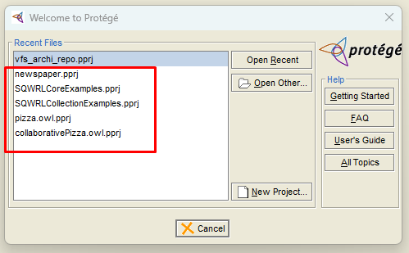
Essential EA Tip: Clean Up Historical Project
For Essential Open Source edition
Config file under Protégé_3.5
protege.properties
In Windows, edit with Administrator permission

Slide 2

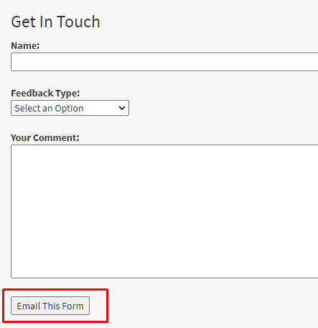
Essential EA Tip: Add mailto in Feedback
Configure “Feedback” as your architecture team’s touchpoint
Demo the settings in source code
js/feedbackformmailer.js

Slide 3
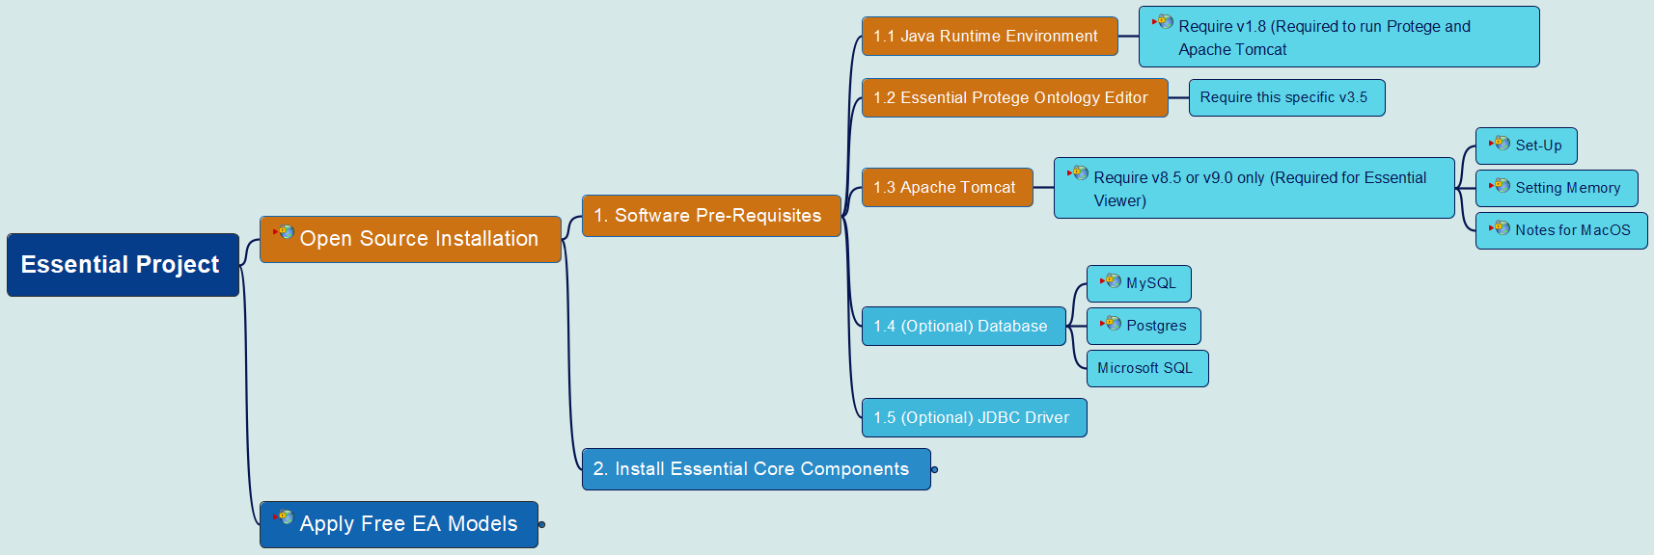



Essential Open Source – Installation – Part 1

Slide 4
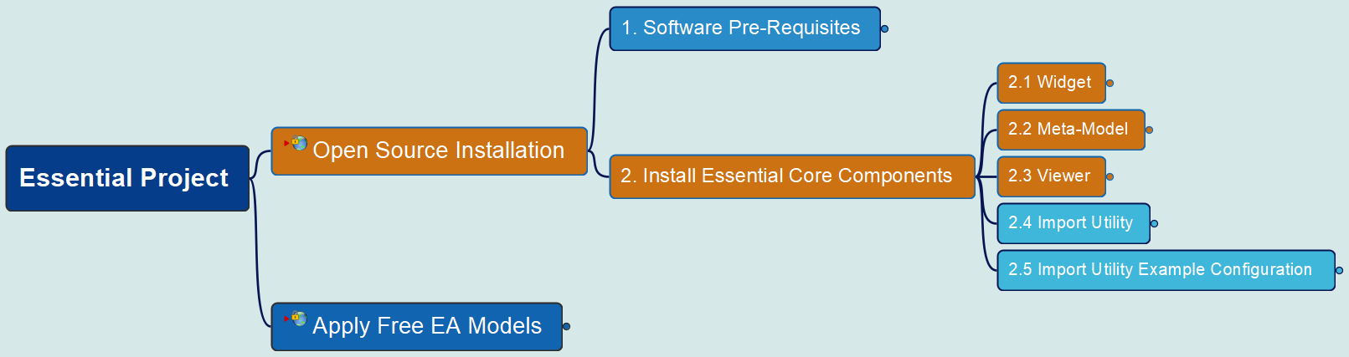
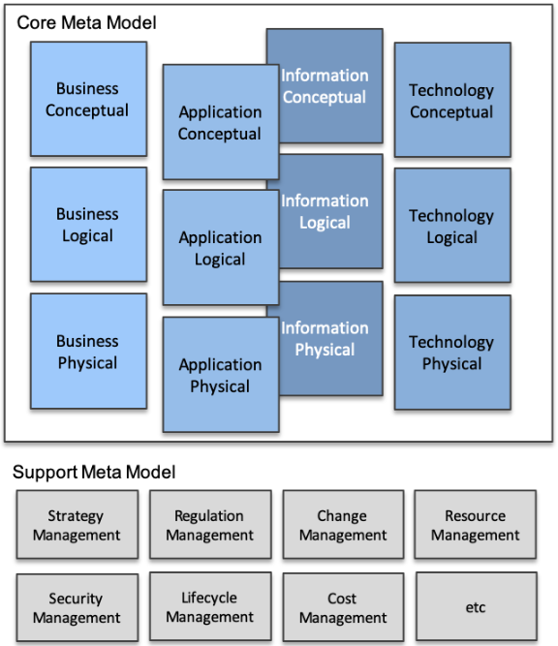
Essential Open Source – Installation – Part 2

Slide 5
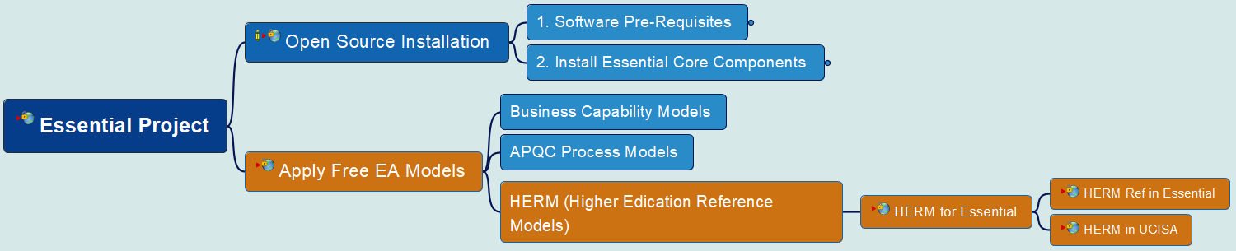
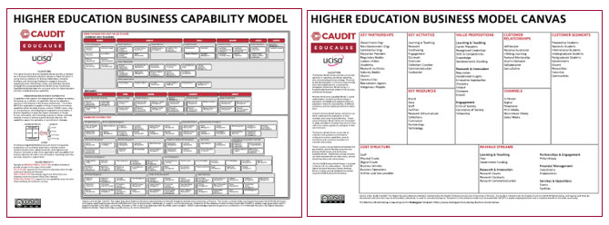

Essential Open Source – Installation – Part 3 (1)

Slide 6
Essential Open Source – Installation – Part 3 (2)

Slide 7
Essential Open Source – Installation – Part 3 (3)

Slide 8
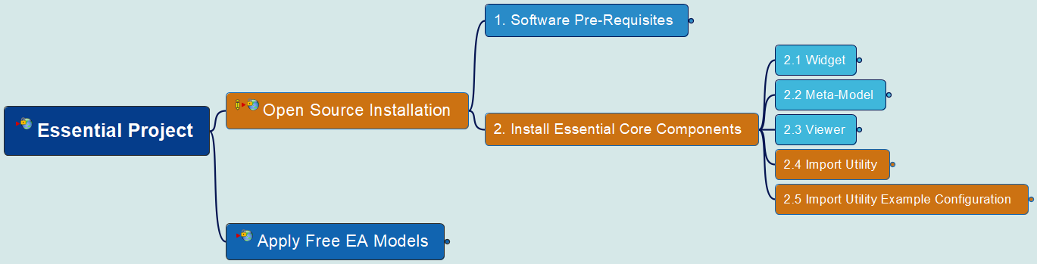
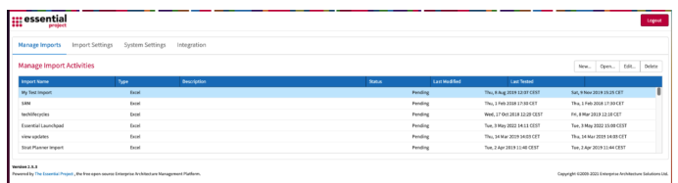
Essential Open Source – Installation – Part 4

